Slide 1
Expedited Delivery Services
Statewide Contract Webinar – February 20, 2013
SPD-CP031
Revised 02/10/11
Georgia State Purchasing Division
http://statepurchasing.doas.georgia.gov

Slide 2

Your Presenter
State Purchasing Division – Statewide Contracts
Presenter Name
Peris Cannon – Contract Issuing Officer
Experience:
7 years Purchasing Experience
7 years Private Industry - Other
Education:
MBA – Southern Polytechnic State University
Certifications: C.P.M & GCPA
Contact Information
Peris.cannon@doas.ga.gov
404-657-4293

Slide 3

Purpose of this Webinar
State Purchasing Division – Statewide Contracts
1.EXPLAIN
the purpose & scope
2. LIST specific details
3. REVIEW
the benefits
4. FIND
on the website
5. REVIEW
How to use this contract/ ordering instructions
6. REVIEW
FAQs
7.LIST
points of contact

Slide 4
Purpose of this Webinar
State Purchasing Division – Statewide Contracts
Inform State of Georgia entities about the new SWC for Expedited Delivery Services with UPS
Scope: Shipping of standard/regular parcels/packages. Within the U.S. (Interstate and Intrastate) and International.
Unique shipments such as those designated by DOT as posing an “unreasonable threat to the public and environment” (e.g. shipment of hazardous or dangerous material, tissue shipments such as biological/medical samples and/or live cultures, cooler shipments that require dangerous goods, biohazardous material, tissue etc.) are not part of the current scope, however, UPS can offer these services as an “option” or “courtesy” service if requested by a State Entity.

Slide 5
Statewide Contract Details
State Purchasing Division – Statewide Contracts
What is the Contract Number?
Contract #: 99999-SPD-SPD0000068-0002
Is it a Renewal?
No
Does it Replace an Existing Contract?
Yes
What is the Contract Term?
Initial Term – Effective 03/01/2013 for one (1) calendar year, with four (4), one (1) year option(s) to renew.
What is the Expiration Date?
02-28-2014
Does it Allow the Use of the P-Card?
Yes
Who is the Person to Contact with Questions:
Peris Cannon – Contract Issuing Officer
Email: Peris.cannon@doas.ga.gov
Tel: 404-657-4293

Slide 6

About UPS
UPS provides package and freight delivery services
  In over 220 countries and territories
  On board more than 220 of our own aircraft
  Connecting through 705 airports
  Using our fleet of more than 95,000 delivery vehicles
  Under the watchful eye of 400,000 UPS employees
Only one company in the world provides such a wide portfolio of logistics services through predominantly owned operations — UPS

Slide 7
About UPS
Two UPS HQ’s are located in GA
  UPS Worldwide Corporate HQ’s – Atlanta, GA
  UPS Supply Chain Corporate HQ’s – Alpharetta, GA
World’s Largest Intergrated Transportation Network
  Logistics – Extensive global & domestic capabilities e.g. 2012 NCAA Basketball
  International Capabilities – Customs specific knowledge and expertise e.g. 2012 Olympics
Technology
  CampusShip, WorldShip, MyUPS.com
Experienced in State Wide Implementations
  PA, VA, MA, VT, NJ

Slide 8
Key Benefits
State Purchasing Division – Statewide Contracts
Key Benefits:
Prices reduced 6.8% (on average) over previous contract
5 percent (%) Fuel Surcharge Rate Cap (both Ground and Express) for life of contract
Fully Integrated Technology Platform to enable shipping cost containment e.g. UPS CampusShip, UPS Electronic Billing Options
UPS Tracking System with real-time, full-visibility available 24 hrs a day, 7 days a week
100% Intrastate Service Delivery to State of GA Zip Codes within One Day
No Pick-Up Charges/No Minimum number of packages per trip, per day, per week or per month
Unprecedented Sustainability Efforts e.g. EPA SmartWay Excellence Award
Money Back Guarantee, time-definite delivery options on service levels

Slide 9
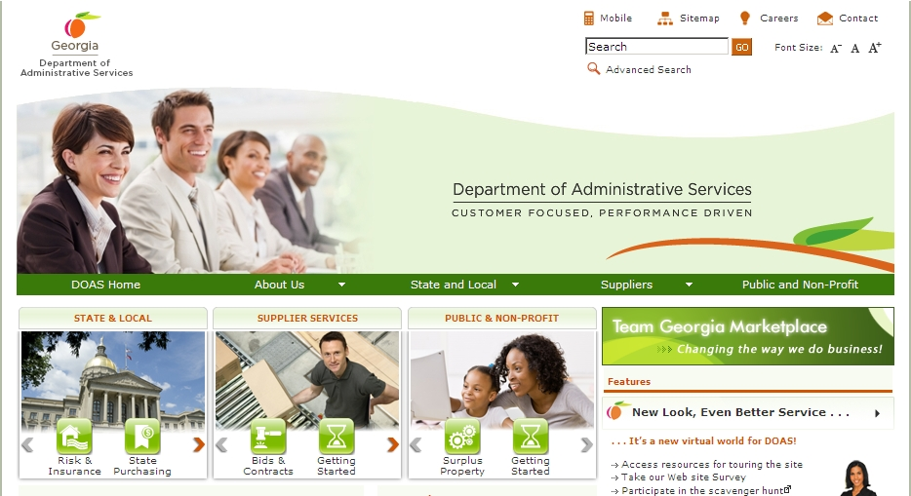
Where to Find this Statewide Contract
State Purchasing Division – Statewide Contracts
1. Visit the DOAS website at www.doas.ga.gov.

Slide 10
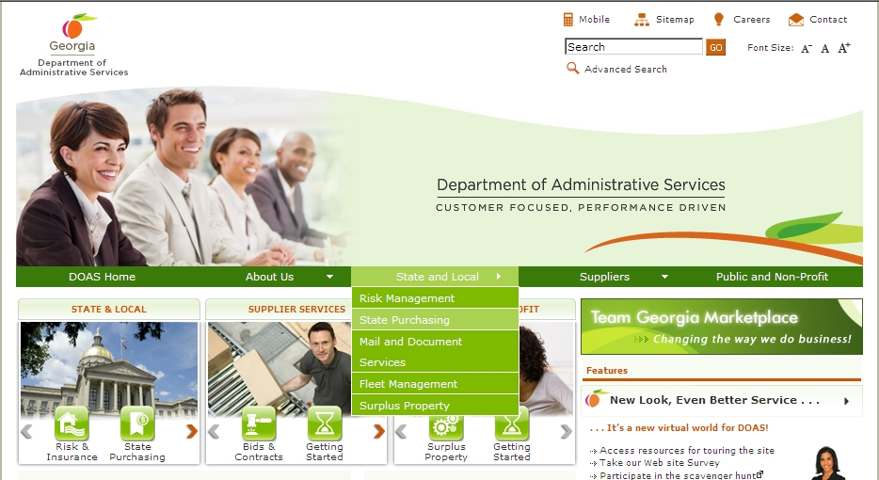
Where to Find this Statewide Contract
State Purchasing Division – Statewide Contracts
Hover over the State and Local section of the screen
2. Hover over the State and Local section of the screen.
3. Click on State Purchasing.

Slide 11
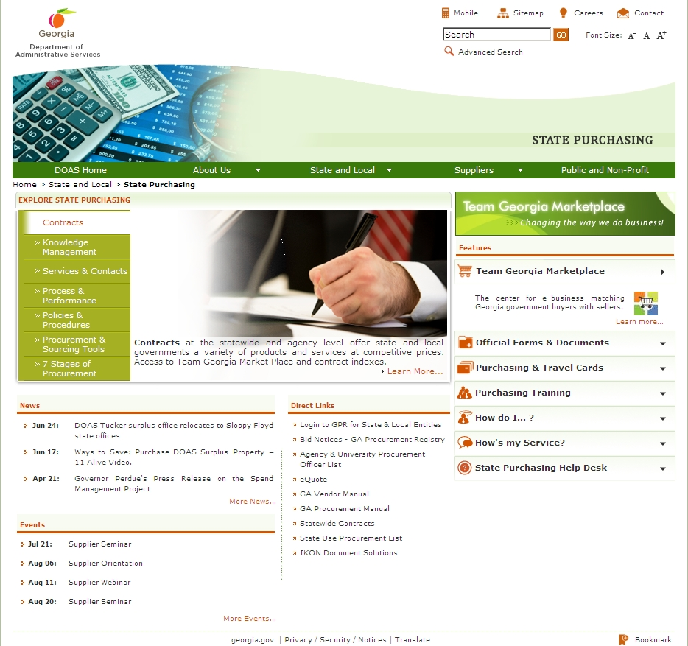
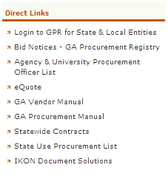
Where to Find this Statewide Contract
State Purchasing Division – Statewide Contracts
Click on Statewide Contracts
4. In the Direct Links section, click on Statewide Contracts.

Slide 12
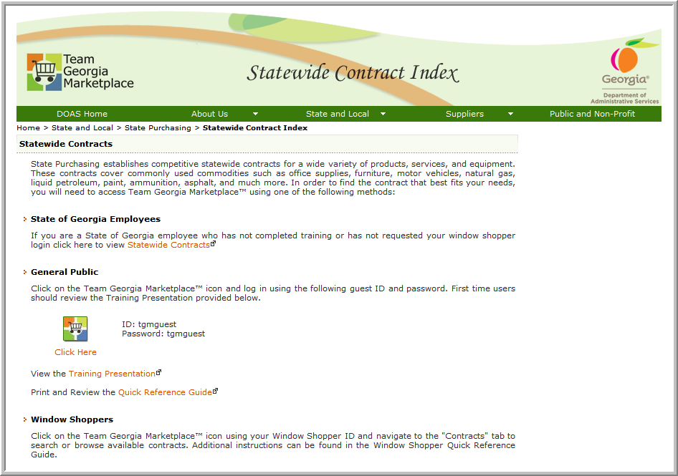
Where to Find this Statewide Contract -- SWC Index for Public
5. To access contract information, click on the Team Georgia Marketplace™ icon to access the Login screen. This User Name and Password is generic and only provides access to contract information.
Use tgmguest
as the User Name and the Password

Slide 13
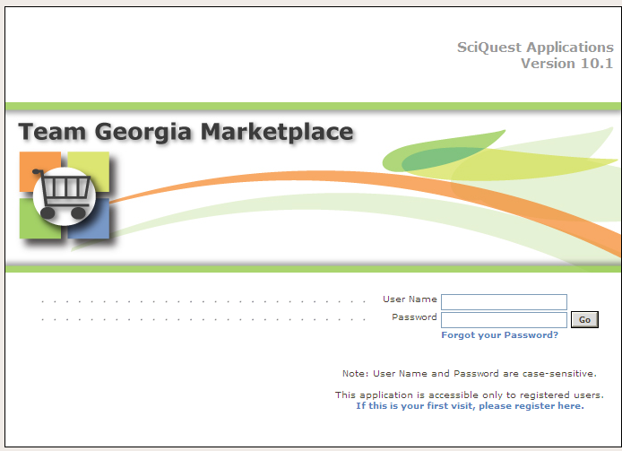
Where to Find this Statewide Contract-Statewide Contracts Index
6. When the Login screen displays, use tgmguest as the User Name and the Password. This generic ID and Password allows access to contract information only.
Use tgmguest
as the User Name and the Password

Slide 14
Where to Find this Statewide Contract--SWC Index for Window Shoppers
You can also click on the Team Georgia Marketplace™ icon to access the same Login screen, but enter your personal Window Shopper User Name and Password. This allows you to access the Statewide Contract Index as well as to shop for items available from the Statewide Contracts.

Slide 15
Where to Find this Statewide Contract-SWC for Window Shoppers
If you are a Window Shopper user, you can access the Statewide Contract Index by entering your personal User Name and the Password once the Login screen displays. Then, click on the Contracts tab.
Use your Window Shopper User Name and Password

Slide 16
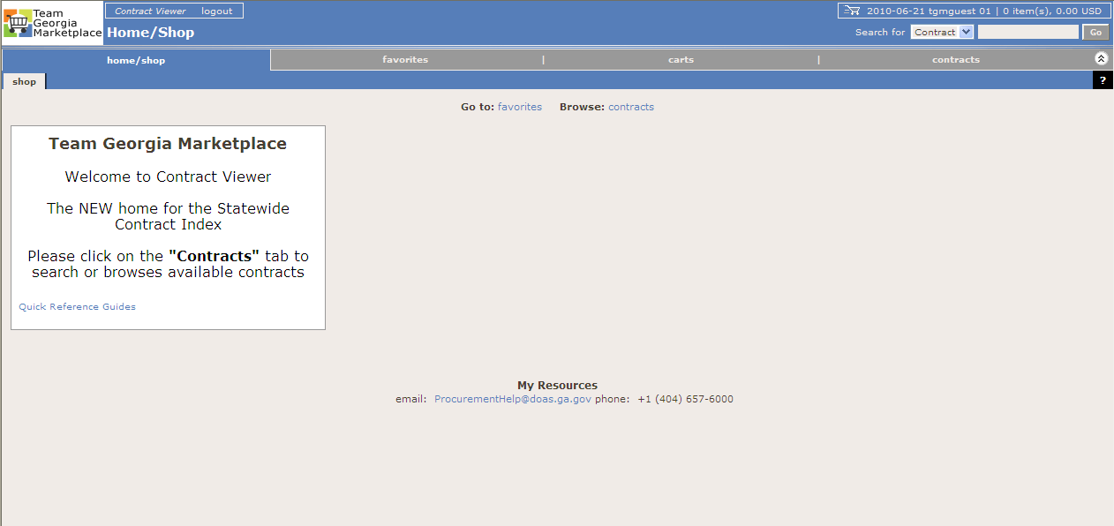
Where to Find this Statewide Contract—
Team Georgia Marketplace Contracts
Once you access the system using the generic or your personal User Name and Password, click on the Contracts tab to access the Statewide Contracts.
Click on the Contracts tab

Slide 17
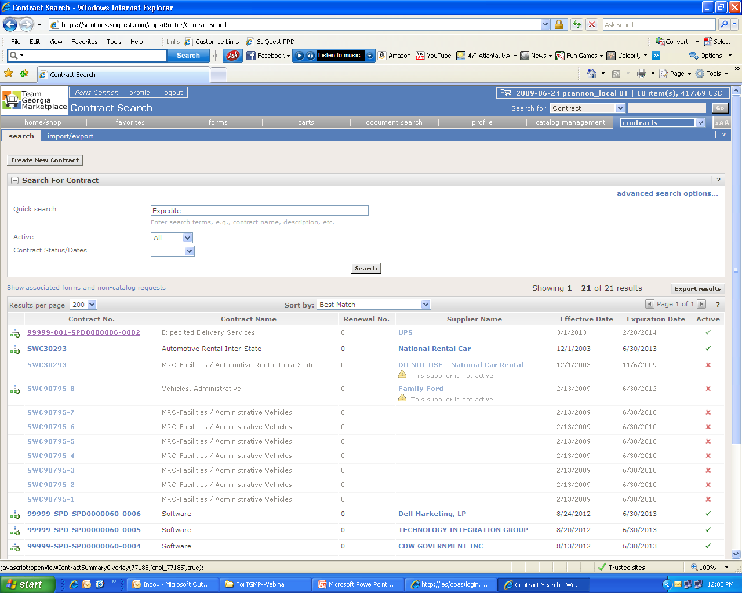
Where to Find this Statewide Contract –
Team Georgia Marketplace Contracts

Slide 18
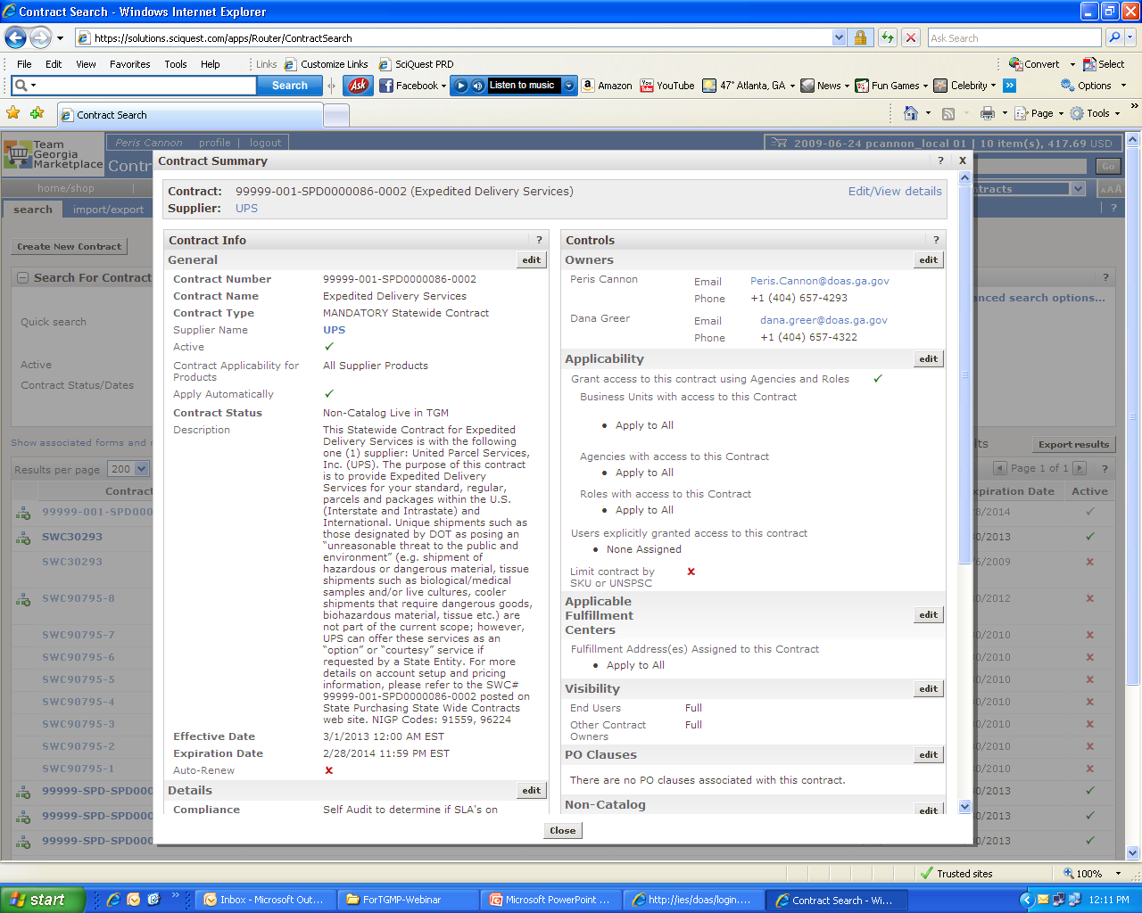
Where to Find this Statewide Contract—
Team Georgia Marketplace Contracts

Slide 19
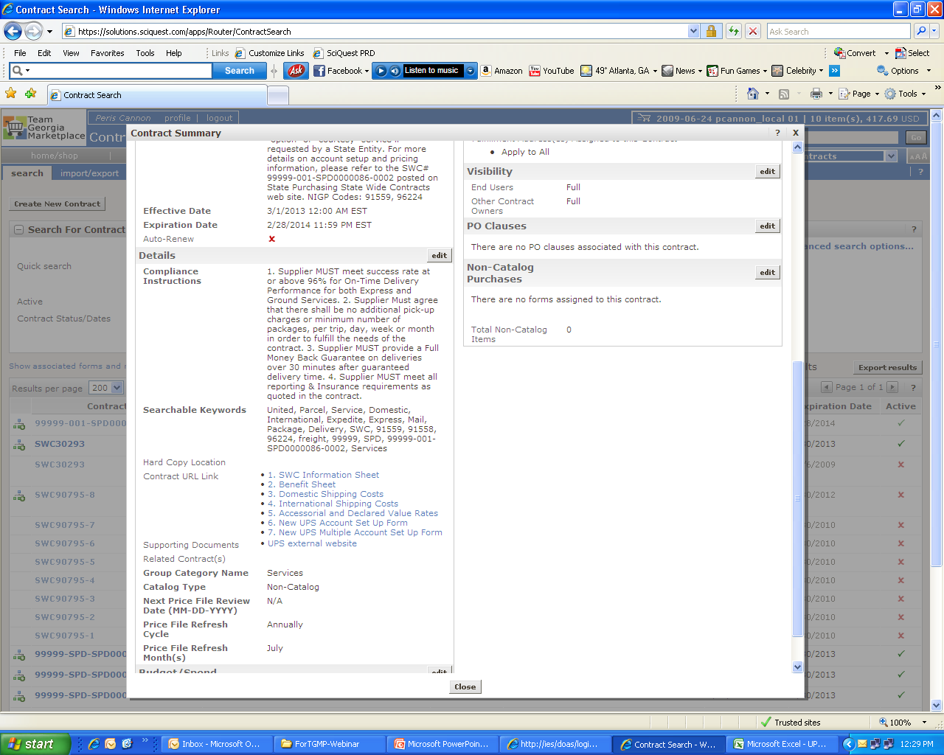
Where to Find this Statewide Contract—
Team Georgia Marketplace Contracts

Slide 20
How to use this contract
State Purchasing Division – Statewide Contracts
(1) Establish a UPS Account utilizing the UPS Account Set-up Forms located in TGMP
**(Account Set-Up takes 24 Hrs – 48 Hrs)**
(2) Current UPS account numbers will automatically be transitioned to the new UPS Contract
(3) Indicate your Preferred Shipping Solution on the New Account Form
(4) We recommend UPS CampusShip as a Desktop Solution. Why?
    Manage Multiple Users in different locations
    Manage costs & streamline cost allocation
    Create shipping privileges for your users
    International shipping options

Slide 21
How to use this contract
State Purchasing Division – Statewide Contracts
(5) Select a Cost Effective Service Level for your Shipping Solutions
Example:
(6) For **Unique Shipments** extended as a “courtesy”..contact the UPS Hazardous Materials Support Center at 1-800-554-9964. For Additional Information: UPS Hazmat

Slide 22
How to use this contract – Shipping Tips
State Purchasing Division – Statewide Contracts
Estimate the Weight of your Package
Determine your Packaging Type
(**Supplies provided by UPS can only be used with Air and Worldwide Express Services**)

Slide 23
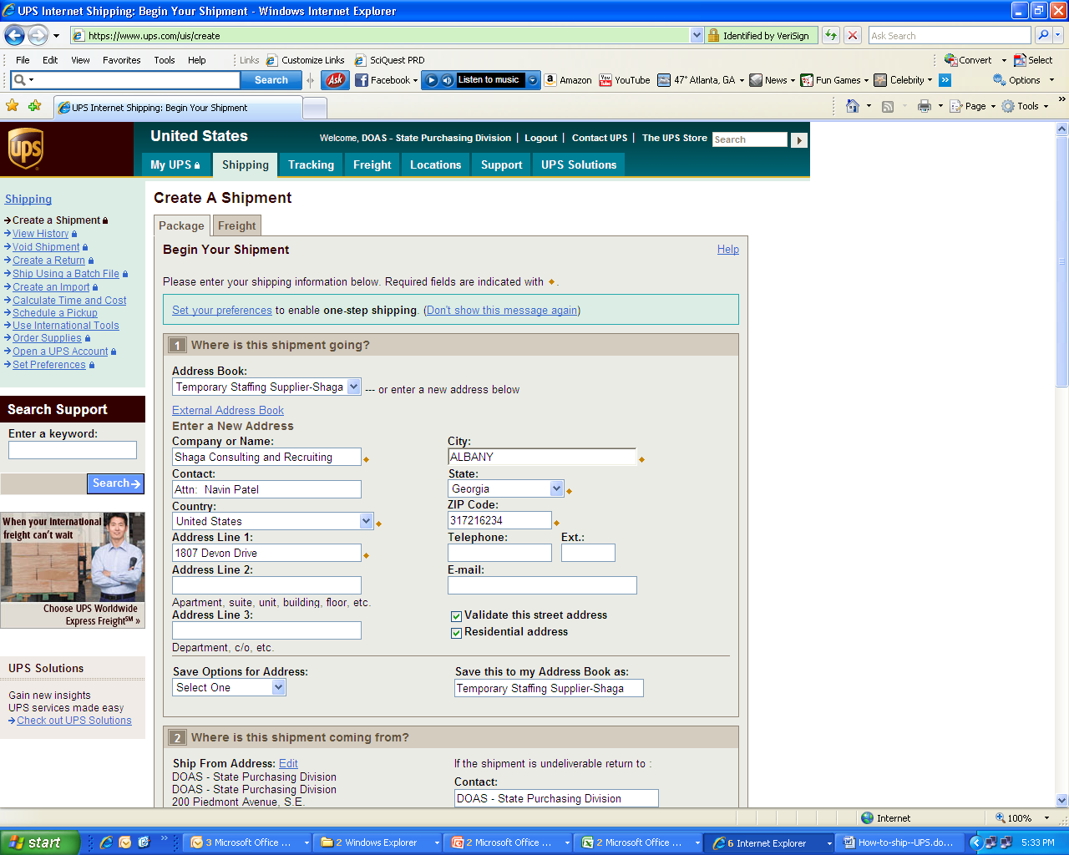
How to use this contract: Shipping a Package
State Purchasing Division – Statewide Contracts

Slide 24
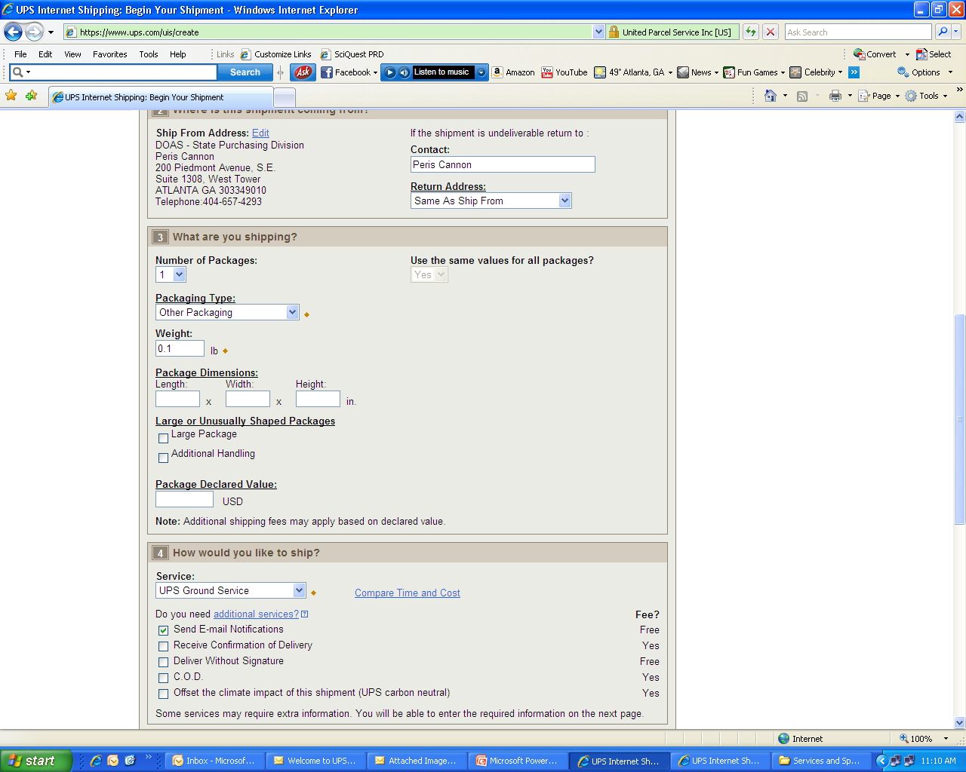
How to use this contract: Shipping a Package
State Purchasing Division – Statewide Contracts

Slide 25
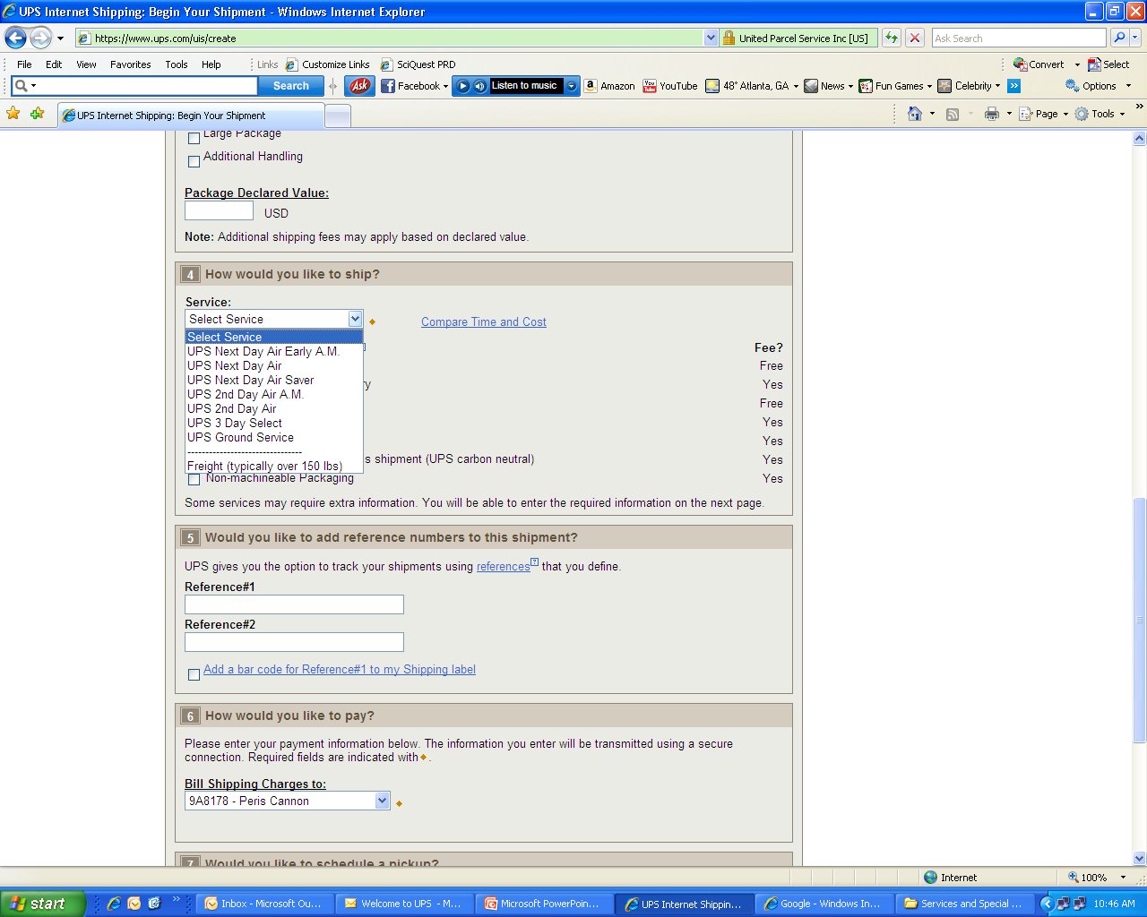
How to use this contract: Shipping a Package
State Purchasing Division – Statewide Contracts

Slide 26
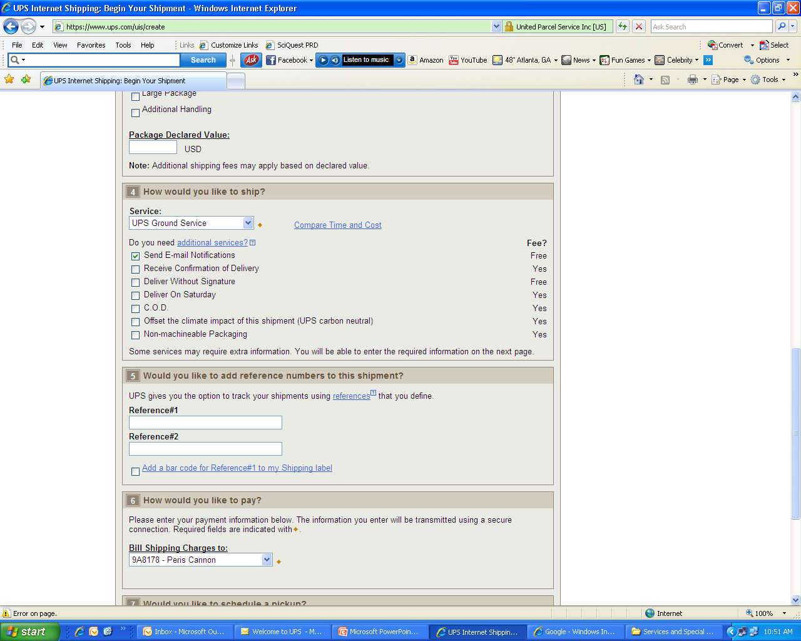
How to use this contract: Shipping a Package
State Purchasing Division – Statewide Contracts

Slide 27
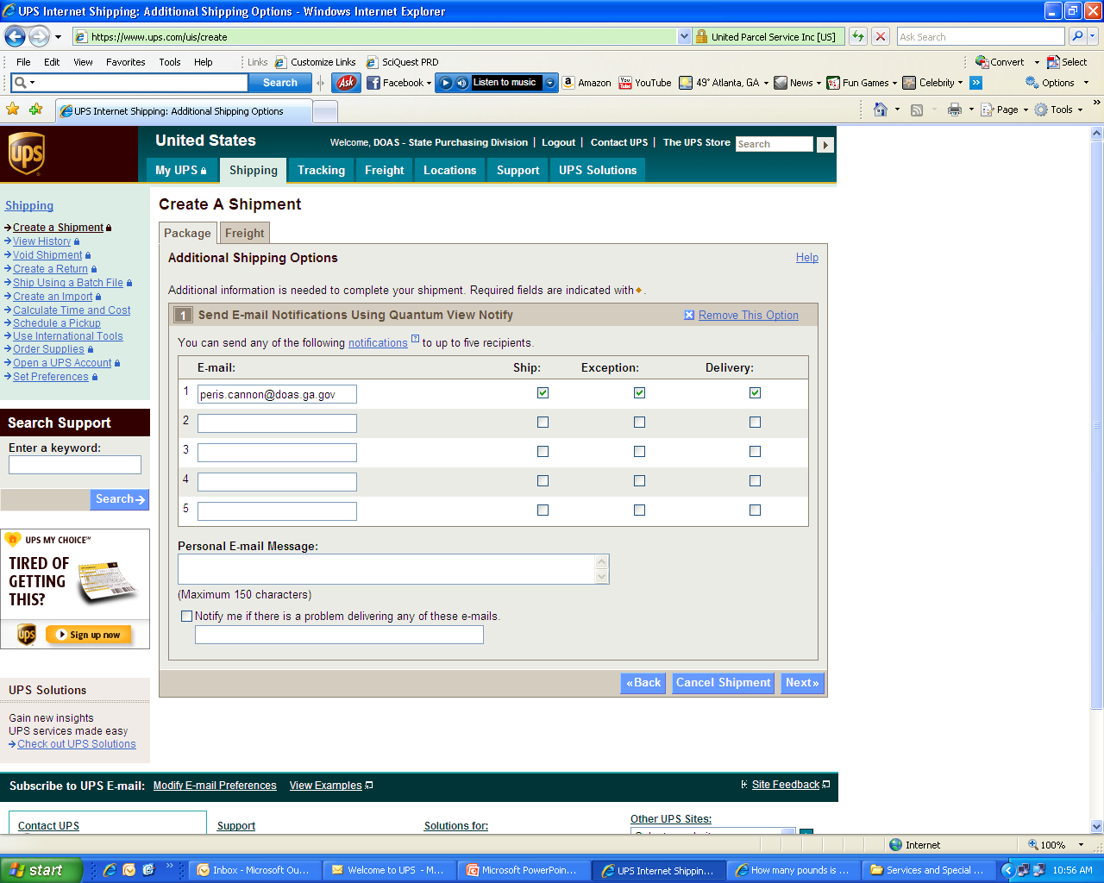
How to use this contract: Shipping a Package
State Purchasing Division – Statewide Contracts

Slide 28
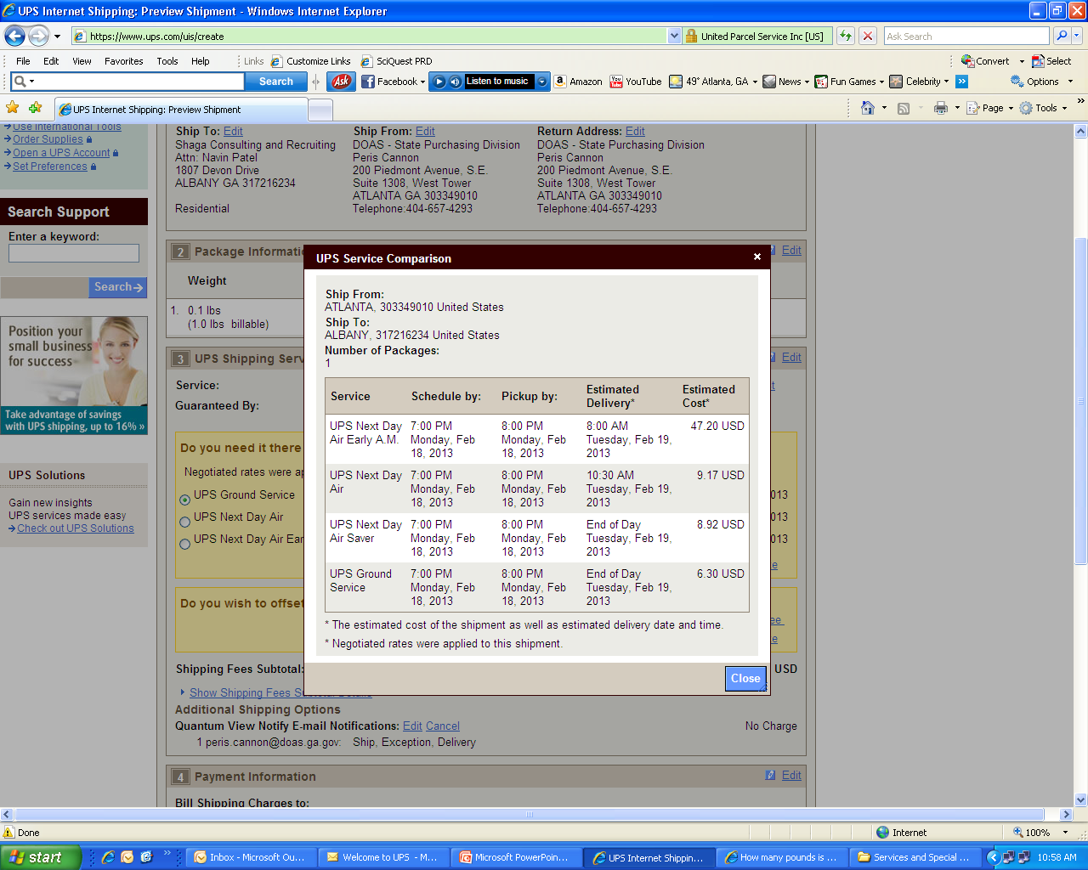
How to use this contract: Shipping a Package
State Purchasing Division – Statewide Contracts

Slide 29
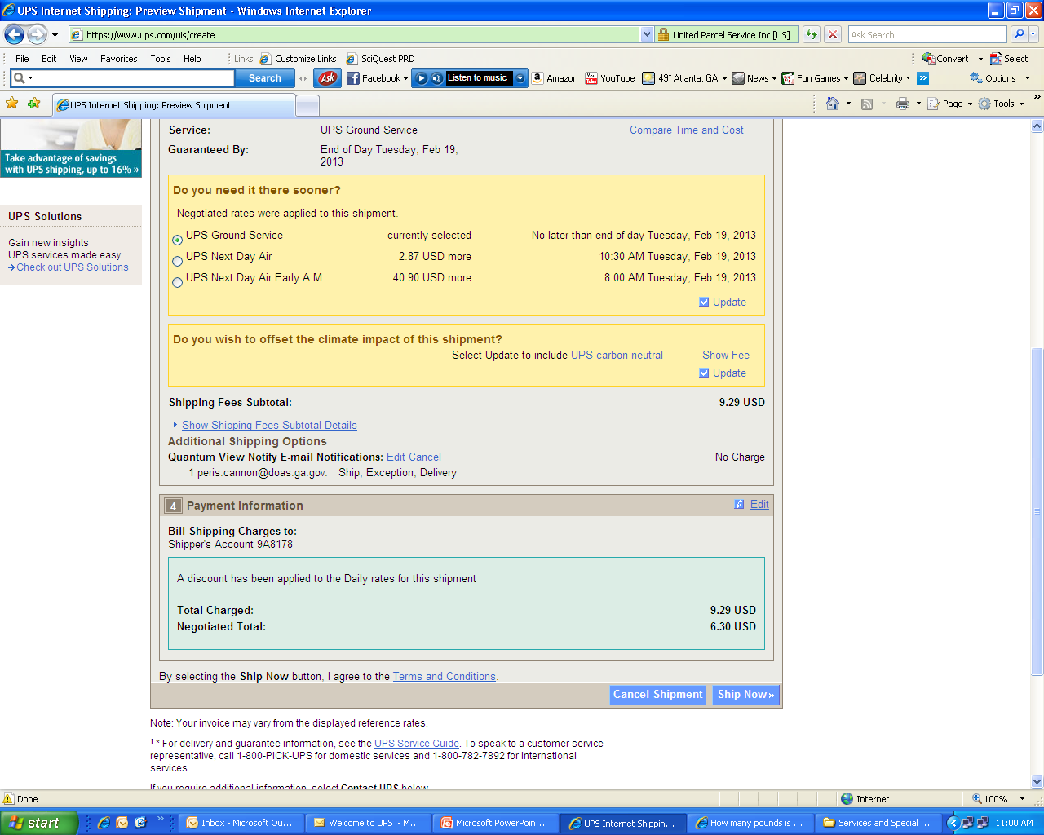
How to use this contract: Shipping a Package
State Purchasing Division – Statewide Contracts

Slide 30
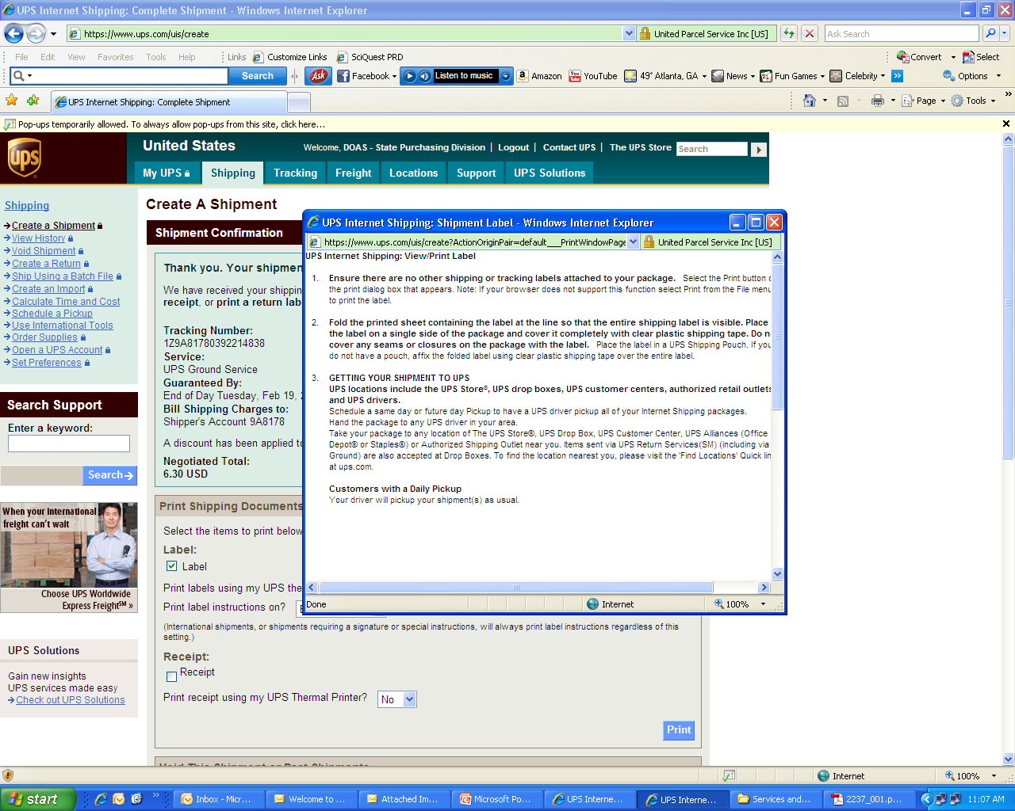
How to use this contract: Shipping a Package
State Purchasing Division – Statewide Contracts

Slide 31
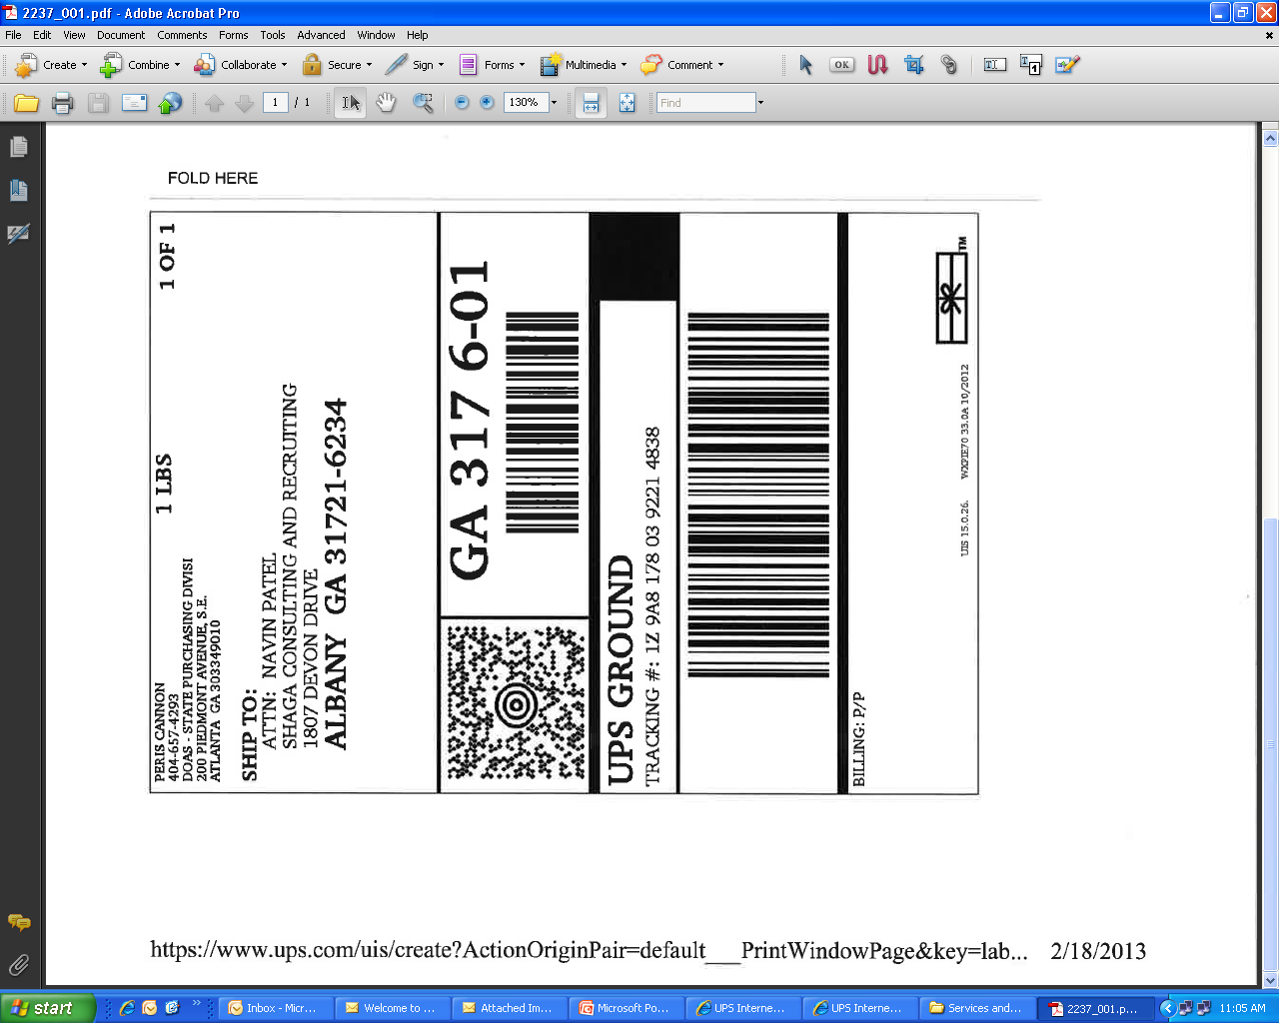
How to use this contract: Shipping a Package
State Purchasing Division – Statewide Contracts

Slide 32
Frequently Asked Questions
State Purchasing Division – Statewide Contracts

Slide 33
For more information
State Purchasing Division – Statewide Contracts
Submit Questions To:
Supplier Contact Information:
Email Address:
Peris.cannon@doas.ga.gov
Person to Contact:
Peris Cannon – Contract Issuing Officer
Phone Number:
404-657-4293
Email Address:
cassiedyer@ups.com
Person to Contact:
Cassie Dyer – Director, Enterprise Accounts – Government Sales
Phone Number:
404-828-3920
This Webinar
A copy of this webinar will be posted on the State Purchasing Division website.

Slide 34
Questions…
?

Slide 35


